Slide 1
Istanbul House Price Prediction and Visualization System
Kaan Akkök Melih Gülbay

Slide 2
Introductıon:
The complexity of the Istanbul real estate market and Turkey’s economic challenges make it difficult to make price predictions and market analysis.
This project aims to overcome these challenges with machine learning and data visualization tools.
It aims to help both real estate professionals and buyers understand market trends and make the right decisions.

Slide 3
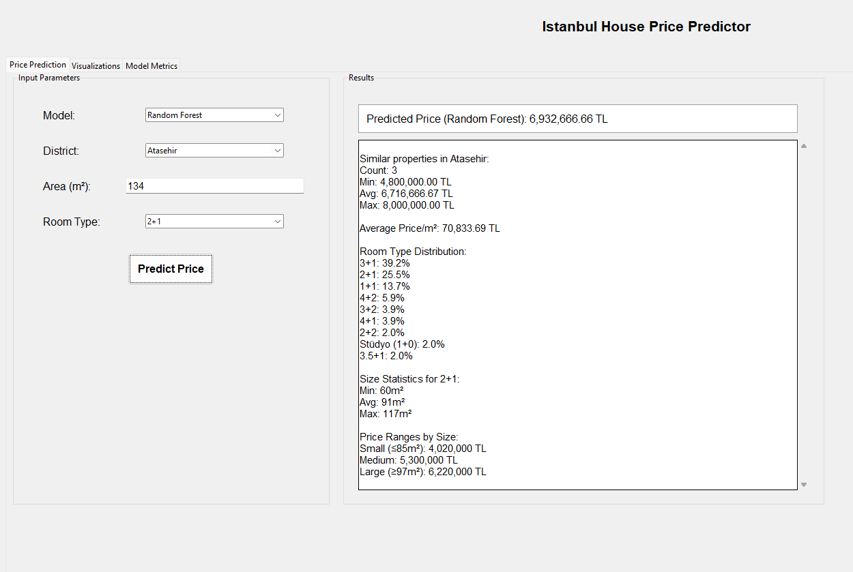
PROJECT GOALS:
Predict house prices with high accuracy.
Enable users to analyze and compare data visually.

Slide 4
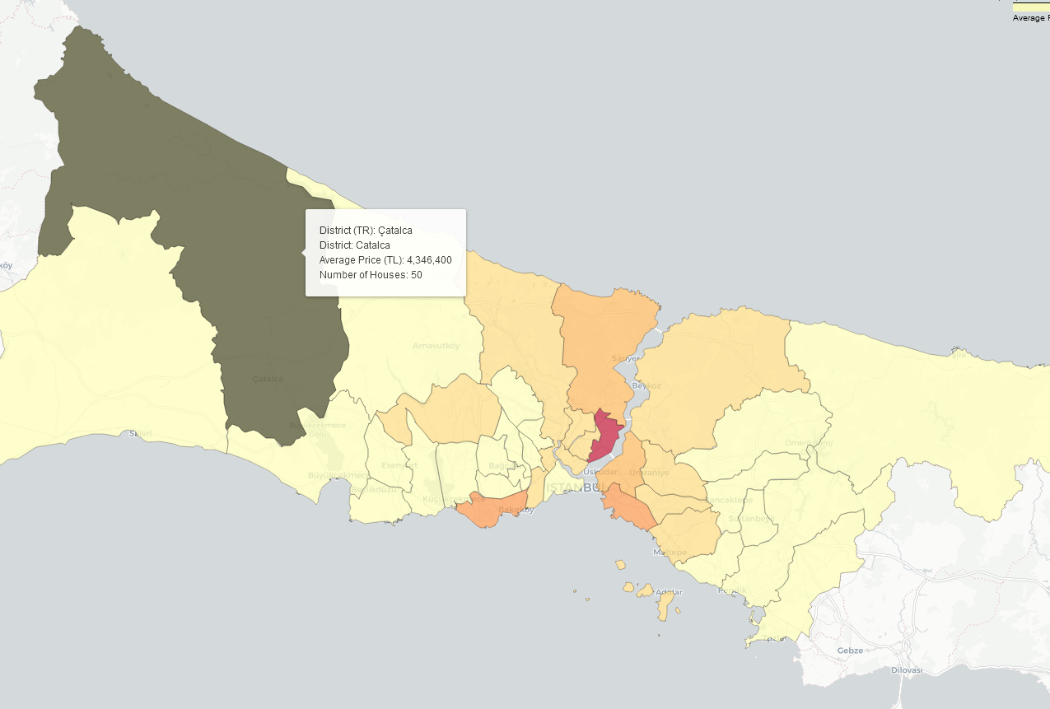
System desıgn:
Data Collection: - we use undetected_chromedriver, selenium and csv libraries for web scraping and data saving.
Machine Learning Models: - we use linear regression, random forest regression, support vector regression, gradient boosting and xgboost models.
Data Visualization: - we use geopandas, folium and matplotlib libraries for data visualization.
User Interface: - we use tkinter library for gui.

Slide 5
Models
1. Linear Regression: Assumes a linear relationship between features and target; simple and interpretable.
2. Random Forest: Uses multiple decision trees to improve accuracy and reduce overfitting; handles non-linear relationships well.
3. SVR (Support Vector Regression): Fits data within a margin; effective in high-dimensional spaces; requires feature scaling.
4. Gradient Boosting: Sequentially builds trees to correct errors; captures complex patterns but can overfit.
5. XGBoost: An efficient, regularized version of gradient boosting; excels in performance and scalability.

Slide 6
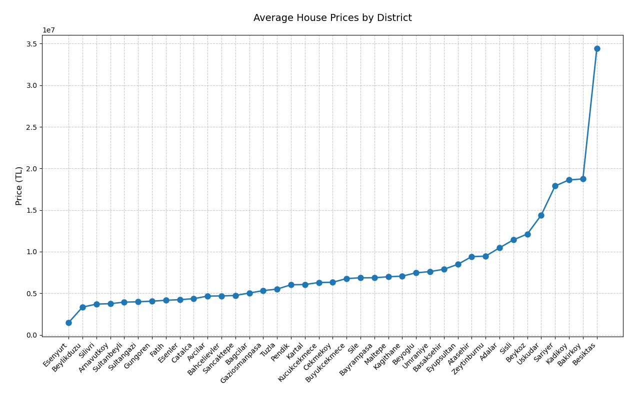
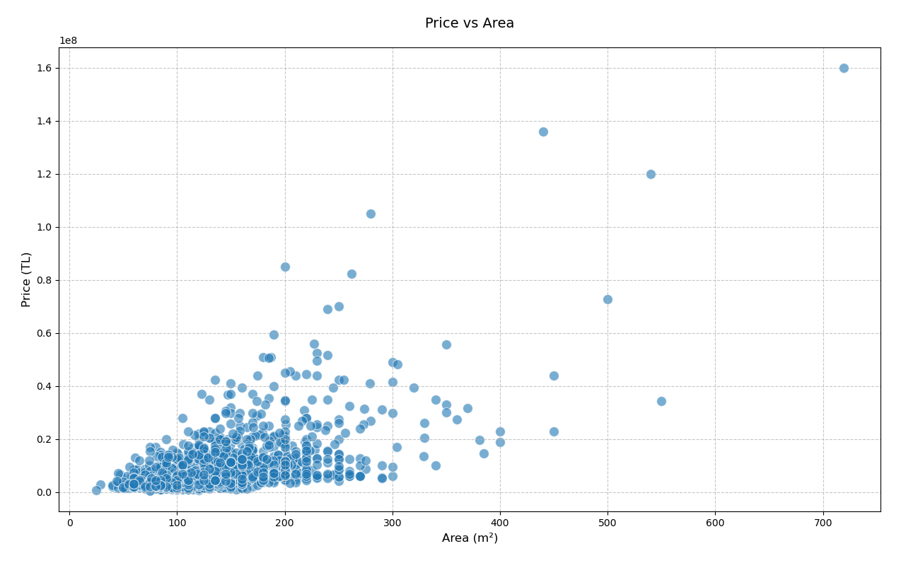

Slide 7
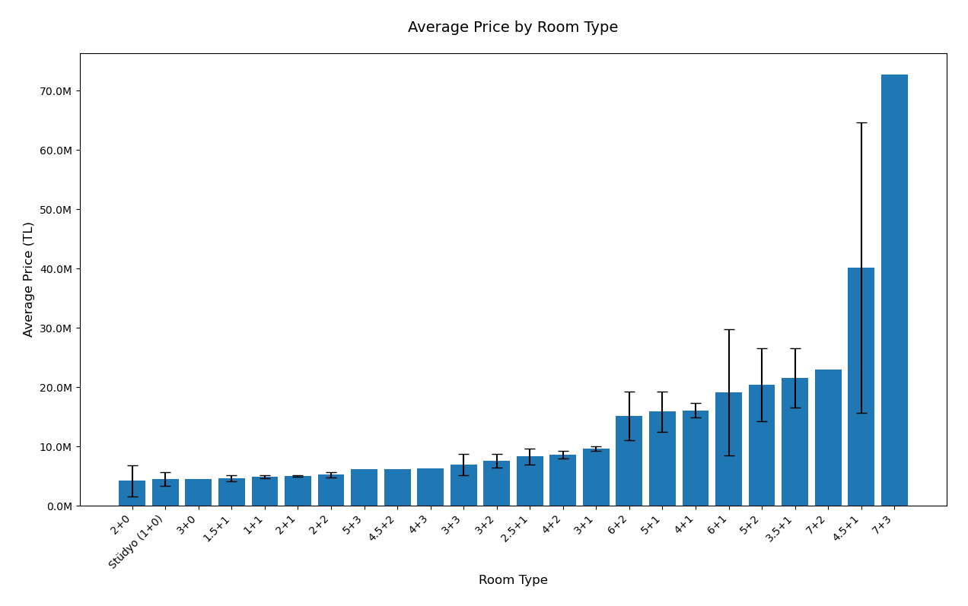
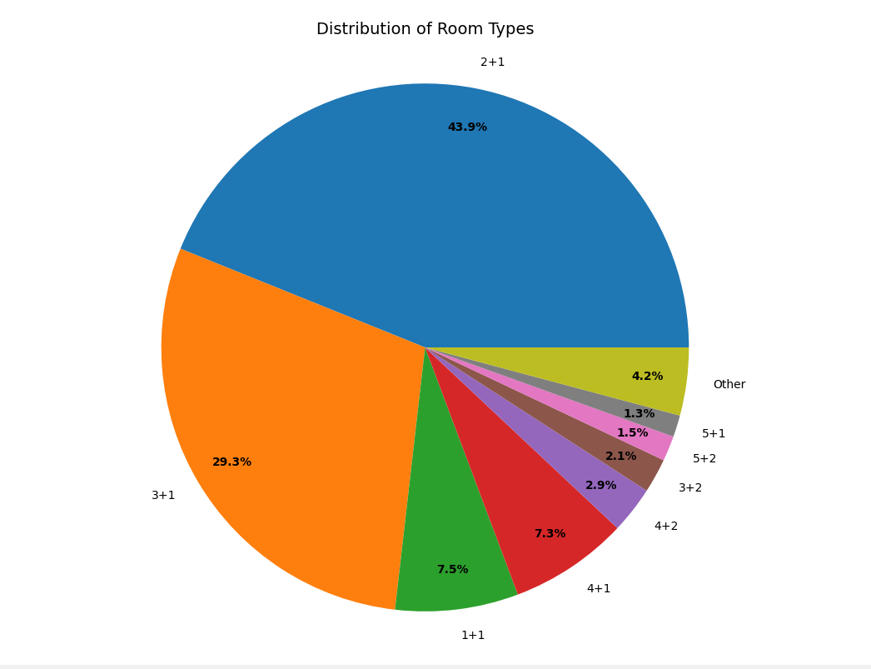

Slide 8
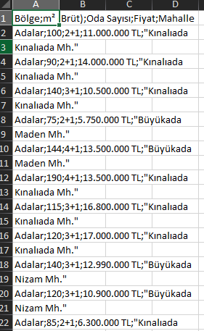
DATASET AND DATA PROCESSıNG:
We retrieve the region, gross, number of rooms, price and neighborhood data of houses in the districts of Istanbul from sahibinden.com with the script.py file and store this data as a csv file (1969 data).
Then we extract "TL" from the price values ​​in the dataset and convert it to a float value, and clean the empty or missing rows from the dataset.
Then we determine the parameters for our models. These are:
X (independent variables): - gross(m^2) - number of rooms - region (converted to binary value with one-hot encoding)
Y (dependent variable): - price(TL)

Slide 9
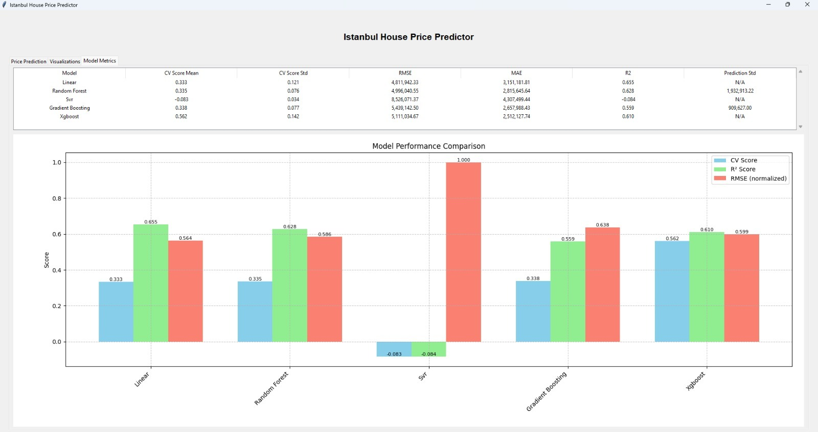
MODEL TRAINING AND EVALUATION:
We train our models with the data we have prepared. Then we evaluate the results of these models.
For evaluation: - Cross-validation - RMSE (Root Mean Square Error) - MAE (Mean Absolute Error) - R^2 Score - models testing
By comparing the obtained metrics, we show the best performing model.

Slide 10
CoNCLUSION:
In conclusion, This Project combines machine learning capabilities with interactive visualization tools to provide a comprehensive solution for house price prediction and market analysis in Istanbul.
THANK YOU FOR LISTENING

